Slide 1
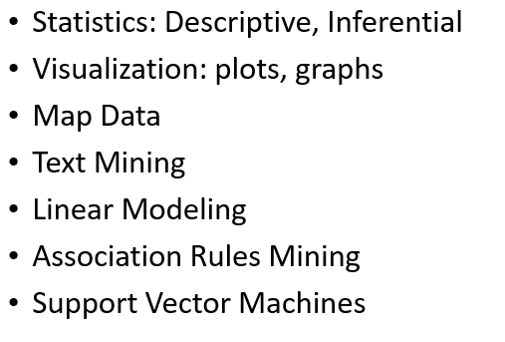
IST687 – Applied Data Science
Methodology
Articulate the business question(s)
Data Acquisition, candidate variables
Data Cleansing, Transformation, Architecture
Analysis
Visualization
Interpretation
Summary Assessment, Actionable Steps
Did you answer the business question(s)
Update #1
Update #2 preliminary
Update #3 Final Assessment
Iterative

Slide 2
Word Document (25%) – Table of Contents
2% - Business Questions - appropriate within the context?
4% - Data cleanse/munge/preparation - transform/clean/munge the data appropriately? What about NAs?
4% - Use of Descriptive statistics - provide context and a basic understanding of the data?
5% - Use of modeling techniques – try 3 different models (for possibly different questions, evaluating results correctly)
5% - Visualization- convey results in an easy to understand manner?
5% - Interpretation of the results/Actionable Insights - Are the results actionable (as compared to just interesting). Are your recommendations/actionable insights supported by your models, if yes, indicate which model supports which recommendation.

